Slide 1
Project 3 Predictive Modeling
Image Super-Resolution
Group 1
Notes:
Hello everyone, we are group 1, there are my group mumber. In this project, we are interested in predictive modeling.

Slide 2
AGENDA
Project Goal
Model Selection
Baseline
Improvement
Evaluation

Slide 3
PROJECT GOAL
Produce a predicted high resolution image as output based on the blurry and low-resolution input.
Evaluation on
Computational Efficiency - Running time on feature extraction and model training
Computational Efficiency - Running time on test data
Predictive Power - Error rate (PSNR)

Slide 4
PROCEDURE
1500
Train Images
(LR+HR)
GBM 4588.63s
Cross Validation
Parameters
XgBoost 537.67s
Extract Feature
Model Selection
Model Training
Test Images
(LR)
Patch-Based Method
GBM
Prediction
(HR)
GBM 4426.86s
65.16s
XgBoost
XgBoost 988.44s
Notes:
First We extract feature from our 1500 low resolution training images by using patch-based method. This process took xx.xx seconds. Then we do the model selection by cross-validation to choose optimal parameter such as interaction depth in GBM, or n rounds in XGboost. With these optimal parameters, we implement them in our training model and make high resolution prediction from test images.
Finally, we will give

Slide 5
FEATURE
X
Y1
g(x)
GBM1
Y2
GBM2
vectorize
Y3
GBM3
GBM4
Y4
Notes:
Feature is the piece of information that describes a part of image or whole image. It is a form of dimensionality reduction.
Here we sample 1000 pixels from each LR image. Then we extract 8 pixels around and 4 corresponding pixels to each sampled pixel in HR image. Thus we generate total 1500*1000*8 features from each color (RGB) in our 1500 LR images and 1500*1000*4 features from each color our 1500 HR images.

Slide 6
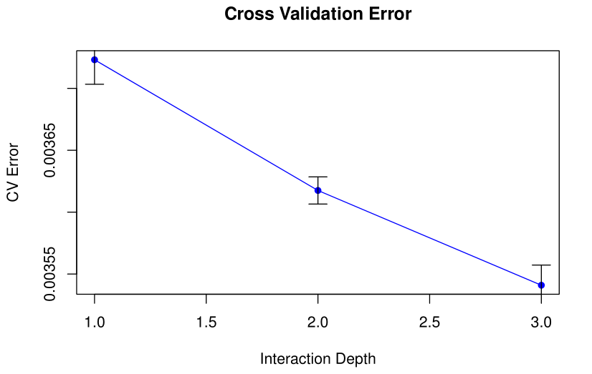
MODEL SELECTION
Baseline (GBM)
 | Ntrees = 200
Depth | 1 | 2 | 3
MSE | 0.00372 | 0.00362 | 0.00354
PSNR | 24.291 | 24.414 | 24.505
Notes:
Basically, we have two models. One is baseline model using GBM algorithm, another one is advanced model using XgBoost algorithm. In the GBM algorithm, when ntree equals to 200, we cross validated on depth 1,2 and 3 to get optimal depth with minimal PSNR. For mse, the smaller the better. But for psnr, the larger the better. From the result, we found depth 3 is best, the PSNR is 24.5.

Slide 7
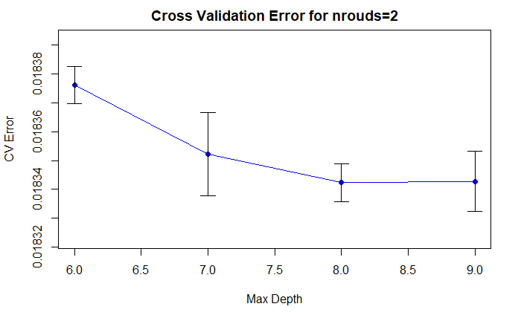
Advanced Model (XgBoost)
 | Nrounds = 2
Depth | 6 | 7 | 8 | 9
MSE | 0.01838 | 0.01835 | 0.01834 | 0.01834
PSNR | 17.357 | 17.363 | 17.365 | 17.365
Notes:
we choose xg boost algorithm as improvement method. We didn’t change the feature extraction process in this model. The parameters we cross validated are max depth and nround. We set Nrounds equal to specific value and changing our Depth to find out the optimal one. First, we set nround equal to 2 and find out depth equals to 8 is the best choice. Here is the plot for mse vs max depth, the intervals with 1 sd for each point.

Slide 8
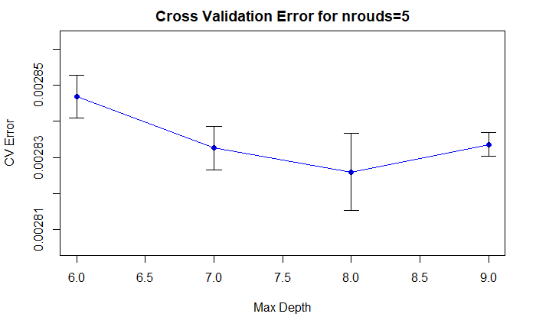
Advanced Model (XgBoost)
 | Nrounds = 5
Depth | 6 | 7 | 8 | 9
MSE | 0.00285 | 0.00283 | 0.00283 | 0.00283
PSNR | 25.456 | 25.478 | 25.489 | 25.477

Slide 9
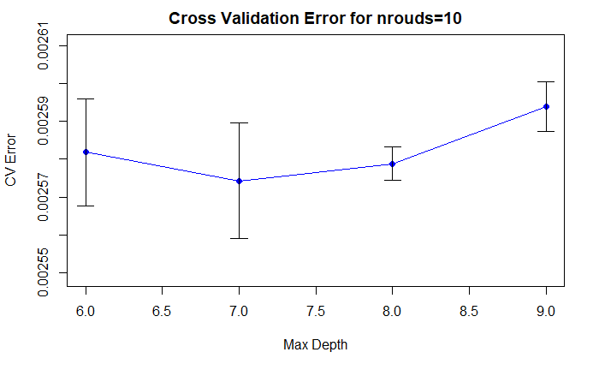
Advanced Model (XgBoost)
 | Nrounds = 10
Depth | 6 | 7 | 8 | 9
MSE | 0.00258 | 0.00257 | 0.00258 | 0.00259
PSNR | 25.881 | 25.893 | 25.886 | 25.860

Slide 10
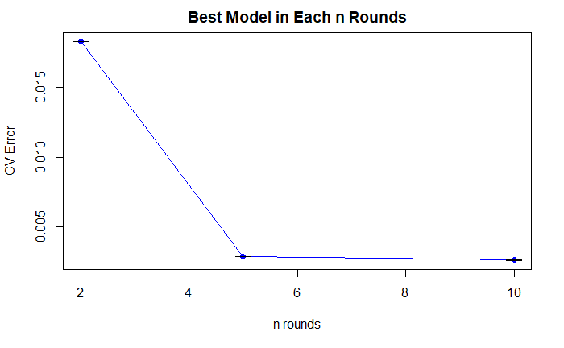
Advanced Model (XgBoost)
XgBoost | Nrounds = 2 | Nrounds = 5 | Nrounds = 10
Depth | 8 | 8 | 7
MSE | 0.01834 | 0.00283 | 0.00257
PSNR | 17.365 | 25.489 | 25.893

Slide 11
EVALUATION
 | GBM | XgBoost
Parameters | Depth=3 | Depth=7, nrounds=10
Running Time | Around 74 mins | Around 16 mins
MSE | 0.00354 | 0.00257
PSNR | 24.509 | 25.893
Notes:
By comparison , we could see both running time and error rate for XGboost are better than gbm algorithm.

Slide 12
GBM
XgBoost
GBM
XgBoost
74 mins
Error
0.00257
Error
0.00354
16 mins
Time
Accuracy
Notes:
There are two main advantage of xg boost：
1. GBM cannot be parallel programing, but xg boost could because it revise the loss function of gbm, so xg boost could train model faster. Here we can see the running time of XG boost is 5 times faster than GBM’S.
2.xg boost include penalty term on the complexity of the trees, so xg boost alleviate the problem of overfitting compared with GBM, xg boost performs better on generalization than GBM. Overall, xg boost has smaller MSE on test data than GBM. So by comparison, the error rate for XG boost are better than GBM algorithm.

Slide 13
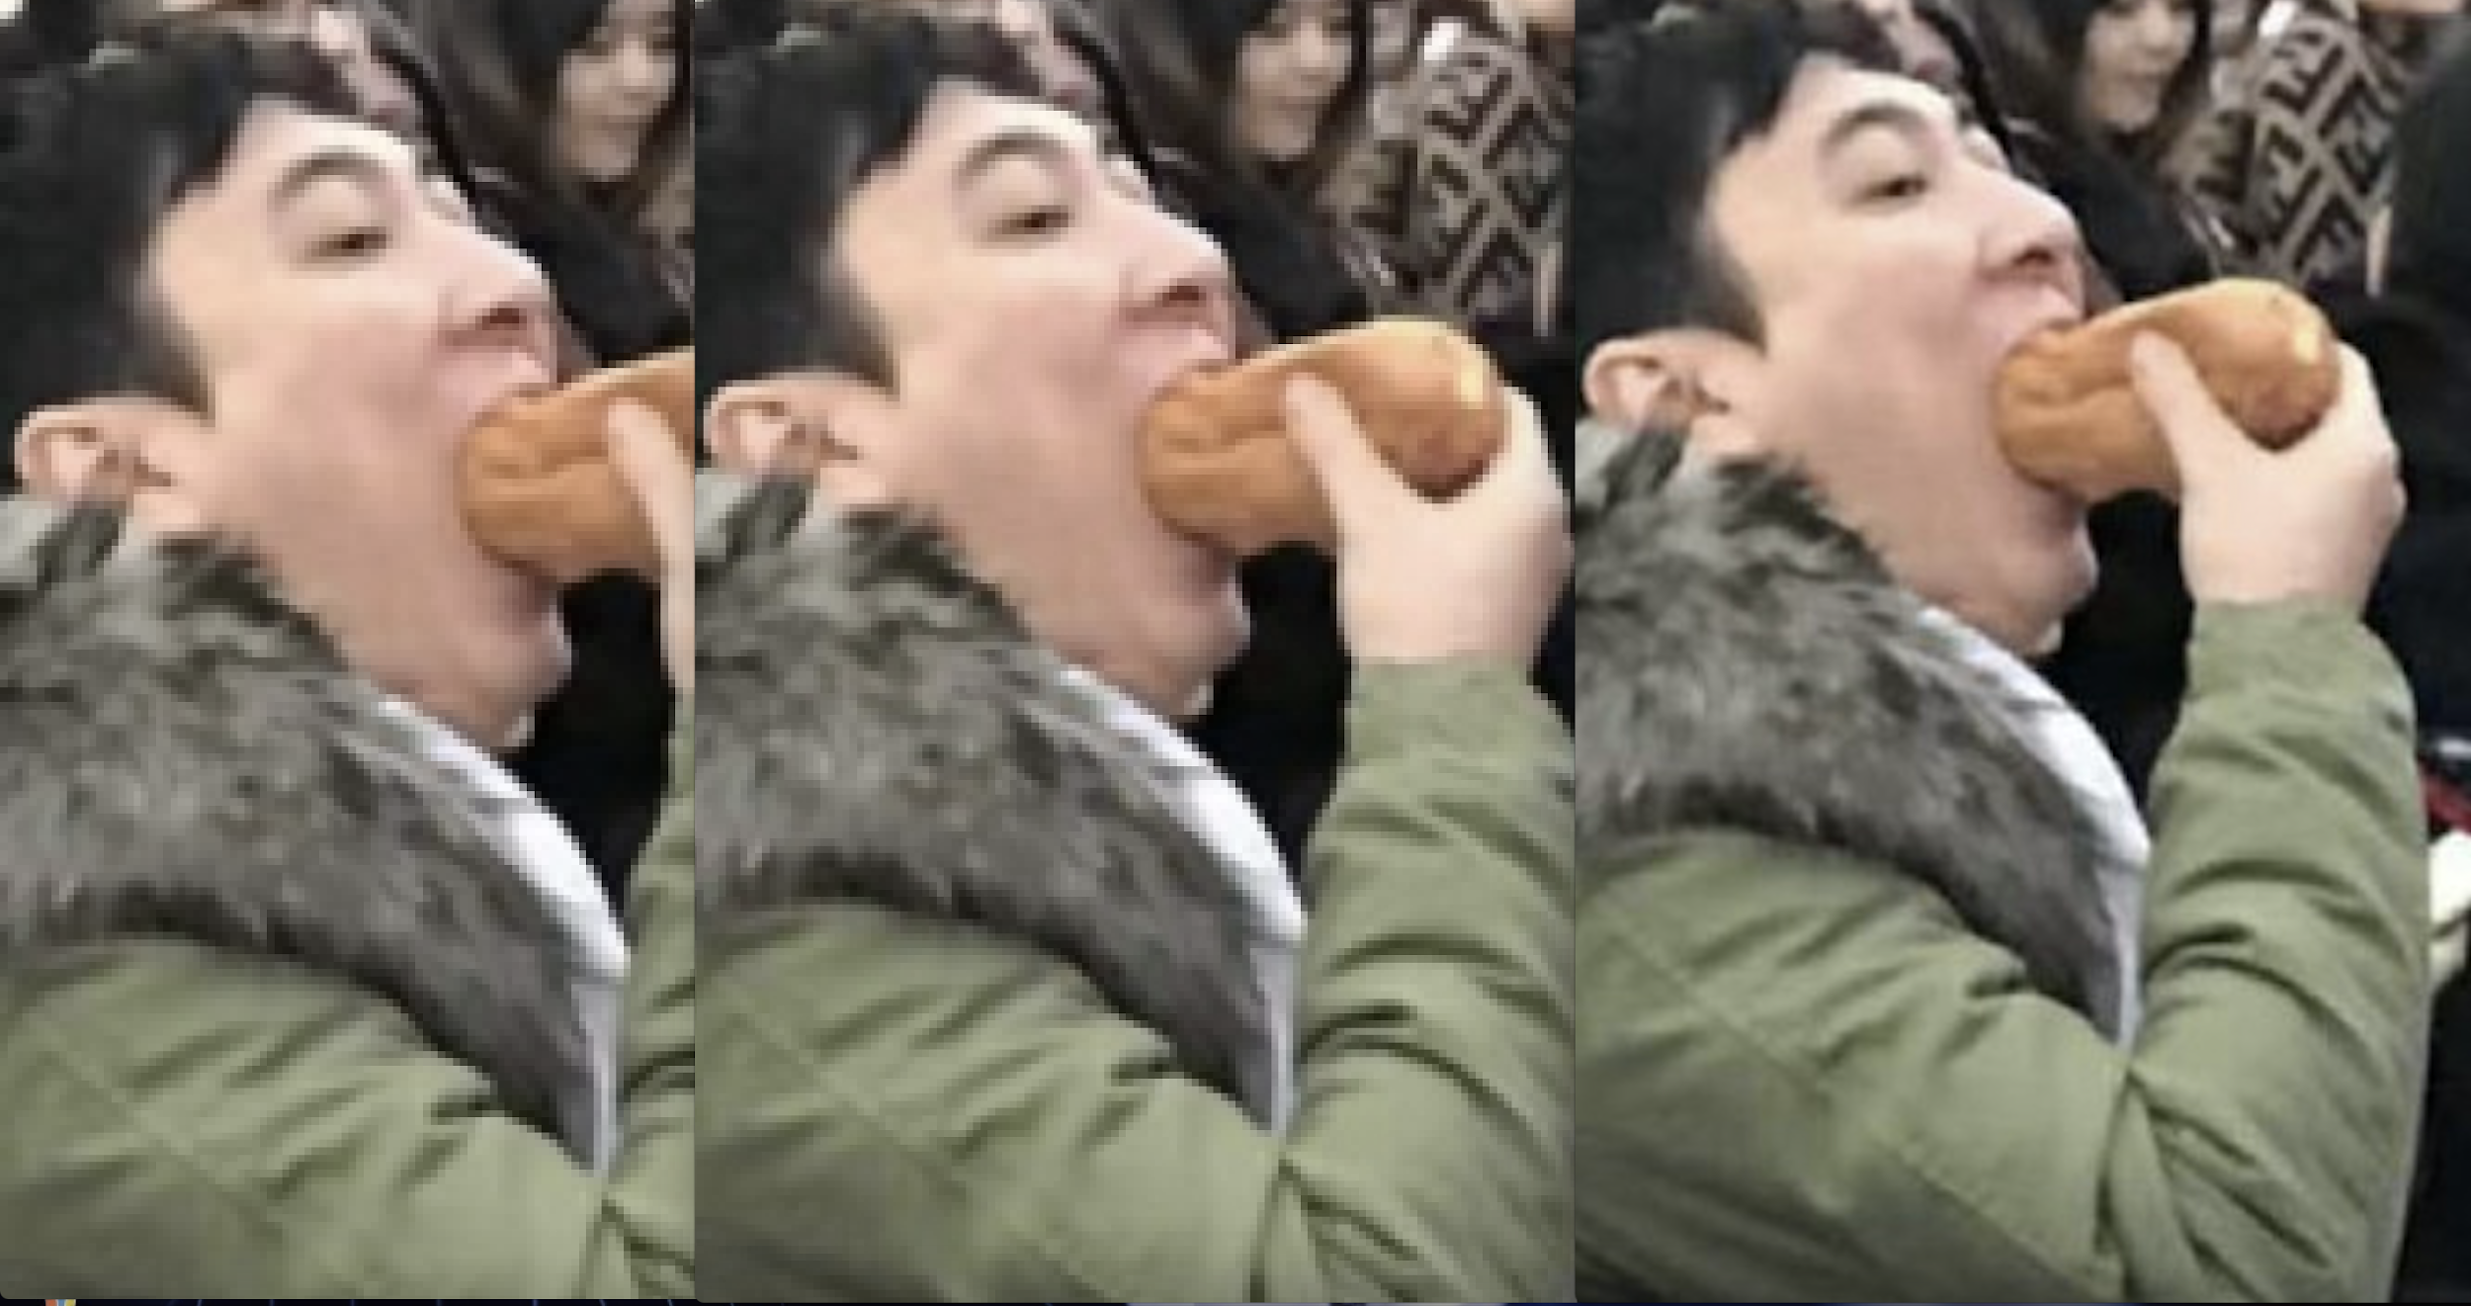
GBM (online picture1)
Low Resolution
Predicted Picture
High Resolution
2.291 s
Error: 0.000477
Notes:
We found 2 pictures from website to test our model performance. The right one is the original picture which is high resolution. The left one is the low resolution image that we resize from the High one. The middle picture is predicted from low resolution using GBM algorithm. This middle one is predicted using GBM. Obviously, the predicted picture using xg boost is more clear than xg boost by eyes.

Slide 14
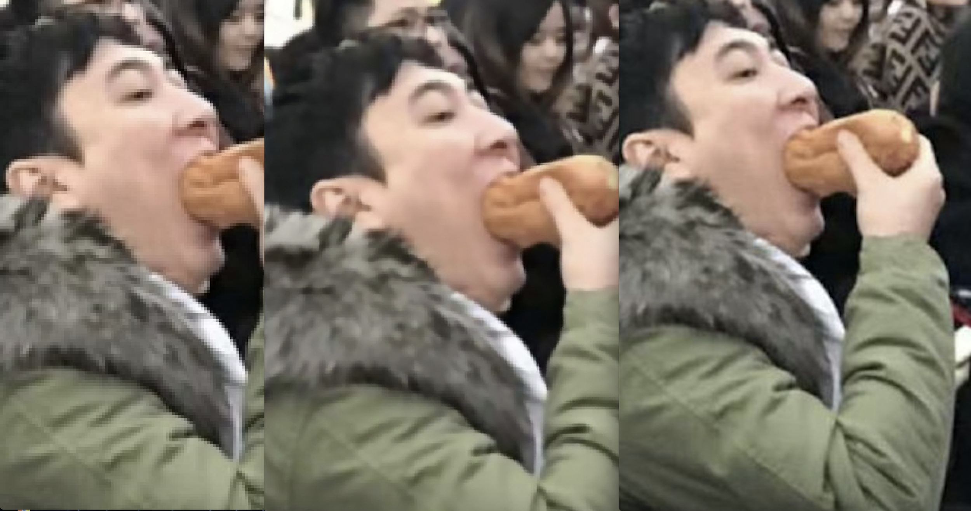
XgBoost (online picture1)
Low Resolution
Predicted Picture
High Resolution
0.379 s
Error: 0.000171
Notes:
LR dim 212 x 234

Slide 15
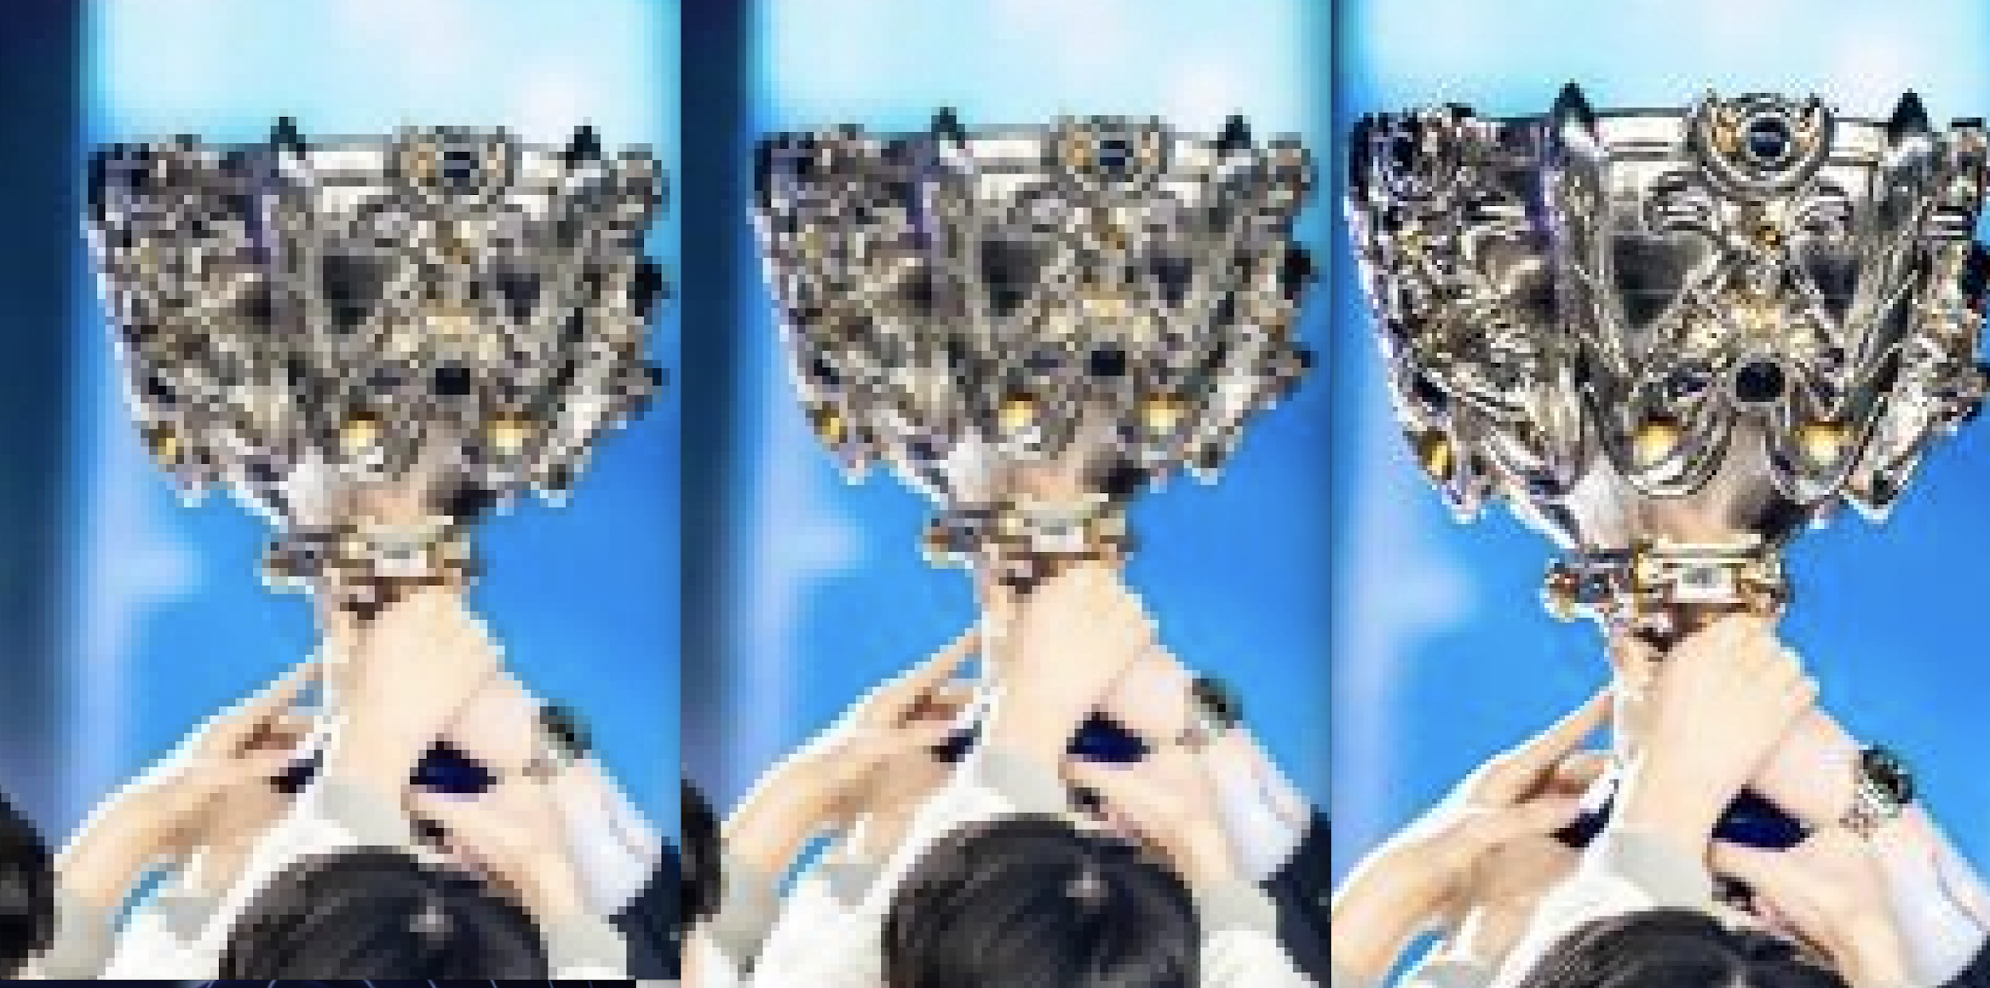
GBM (online picture2)
Low Resolution
Predicted Picture
High Resolution
6.35 s
Error: 0.000973

Slide 16
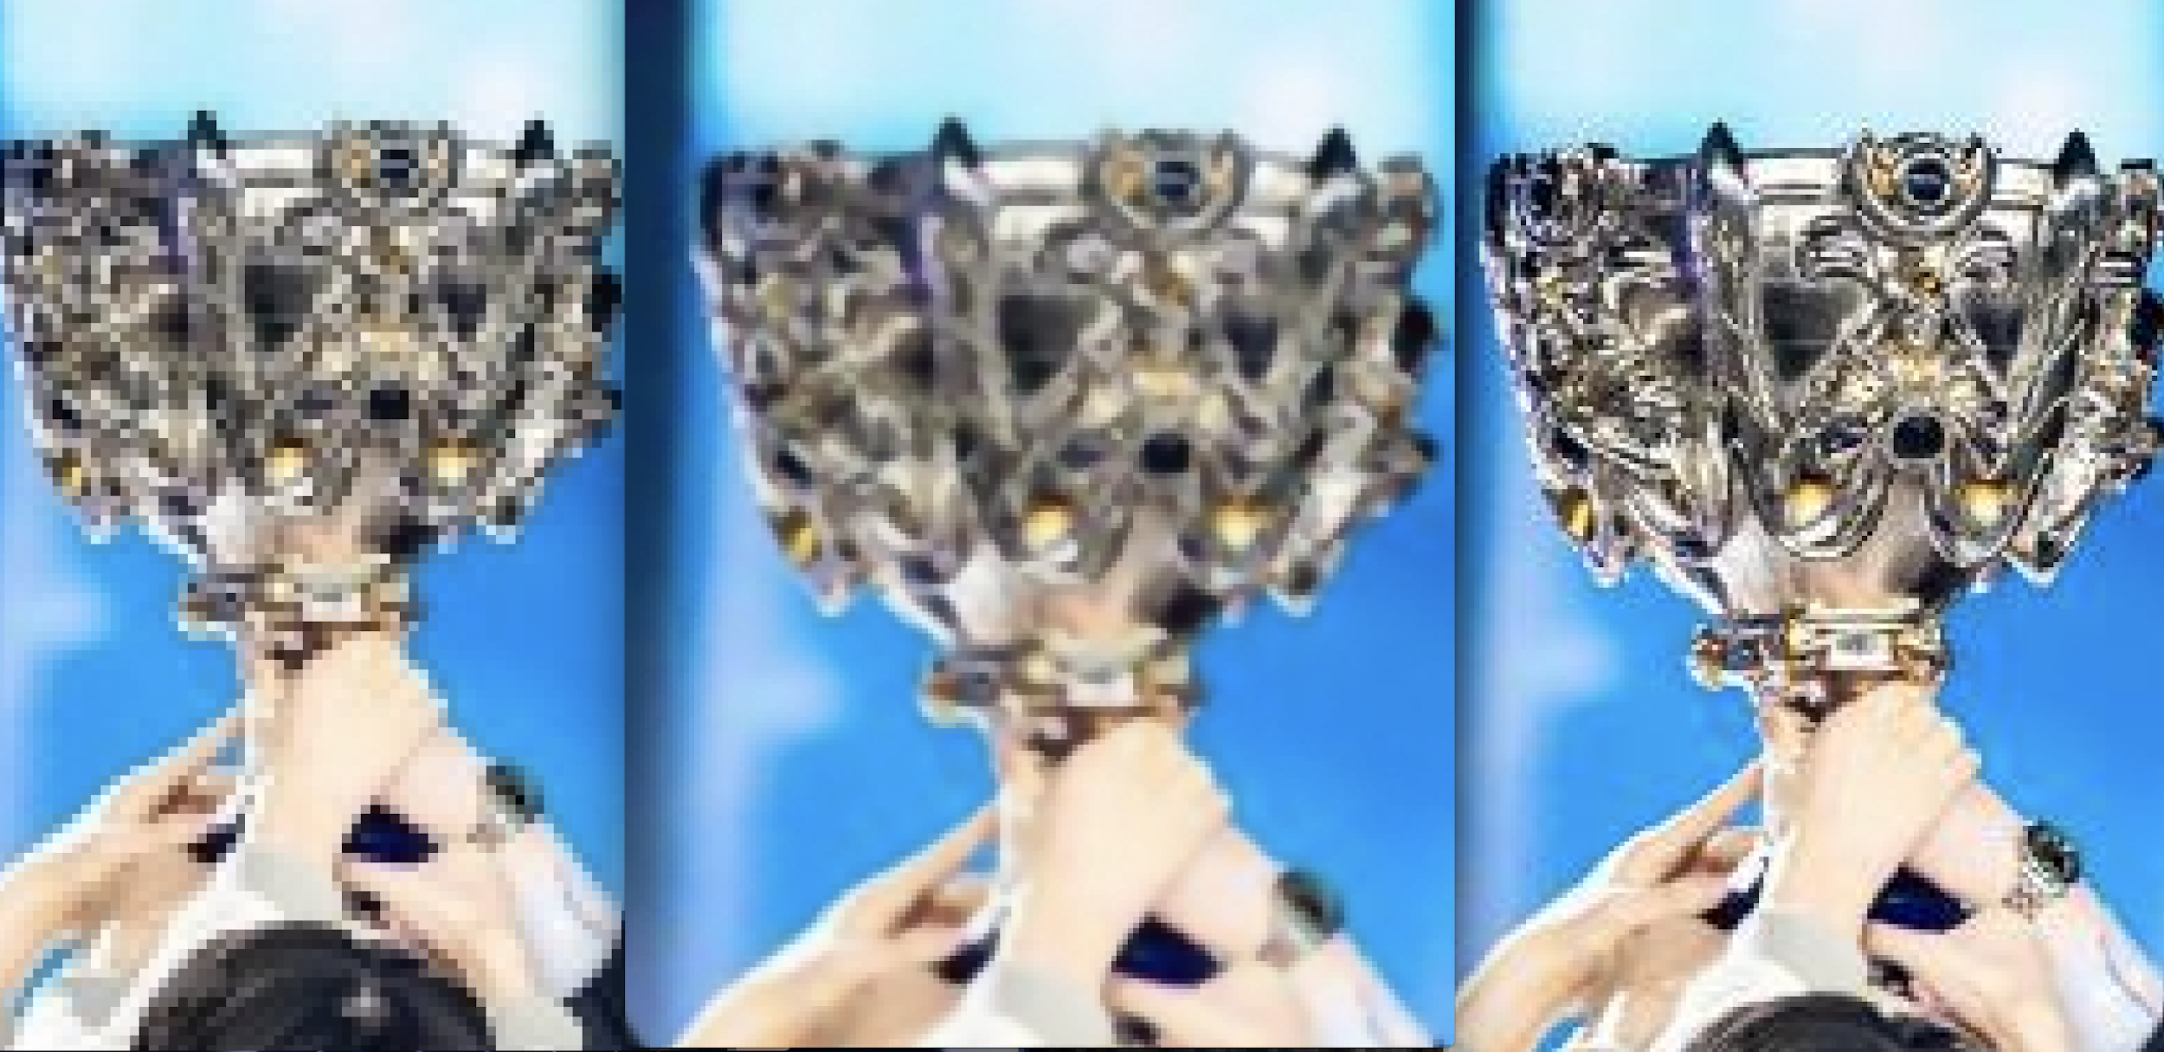
XgBoost (online picture2)
Low Resolution
Predicted Picture
High Resolution
1.963 s
Error: 0.000718
Notes:
LR dim 472 x 285

Slide 17
REPRODUCED PERFORMANCE IN CLASS
 | GBM | XgBoost
Parameters | Depth=3 | Depth=7, nrounds=10
Running Time | Around 72.8 mins | Around 21 mins

Slide 18
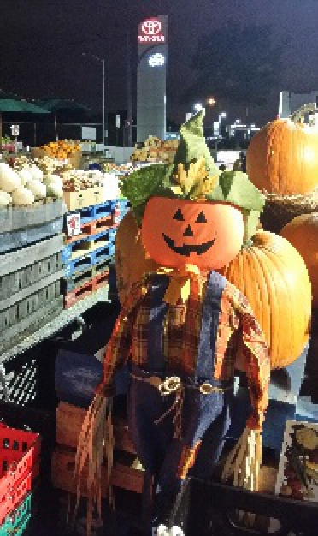
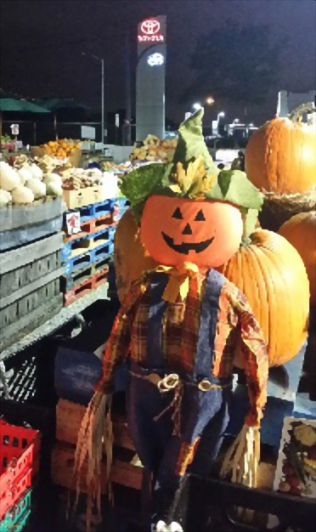
LR Input
HR GBM
HR XgBoost

Slide 19
Thanks!
Any questions?

